Slide 1
Meeting 1 Welcome to GPS II/MAPP Program

Slide 2
License Rights to OCFS
Center for Development of Human Services, Institute for Community Health Promotion, SUNY Buffalo State acknowledges the State of New York’s and the Office of Children and Family Services’ royalty-free, non-exclusive and revocable license to reproduce, publish, distribute, or otherwise use any and all material herein for the limited purpose of training GPSII/MAPP Leaders and for as long as such materials and such training are deemed appropriate by NYS OCFS.
The Children’s Alliance of Kansas (CAOK) is the current national owner of the copyrighted “toolbox” of MAPP programs. NYS Office of Children and Family Services (NYS OCFS)/Center for Development of Human Services (CDHS) has permission from CAOK to provide MAPP programs (GPSII/MAPP, Caring For Our Own, Deciding Together, Shared Parenting, Mini-MAPP, and Child Sexual Abuse) to certify leaders through leader certification workshops and directly to foster/adoptive parents in New York State.
In order to better meet the needs of children and families in New York State, PS-MAPP was revised in 2004 and renamed GPSII/MAPP. Further revisions were made in 2005 after considering the feedback from MAPP Leaders throughout the state, and minor revisions and reformatting occurred in 2009. Significant revisions to the content and updating to reflect best practice and legal changes in New York State were made and approved by NYS OCFS in 2012 for this edition.
© 2009 Children’s Alliance of Kansas. Revised with permission NYS OCFS.

Slide 3
Matching Activity
Find your match
Introduce yourself (name, where you live, what brought you here)
Introduce your match

Slide 4
12 Skills for Successful Fostering or Adopting
Know your own family
Communicate effectively
Know the children
Build strengths; meet needs
Work in partnership
Be loss and attachment experts

Slide 5
12 Skills for Successful Fostering or Adopting
Manage behaviors
Build connections
Build self-esteem
Assess health and safety
Assess impact
Make an informed decision

Slide 6
Successful Teams
Name one achievement of your team
Name one quality that made your team successful (3 minutes)
This Photo by Unknown Author is licensed under CC BY-SA-NC

Slide 7
Ways Information is Shared in the GPSII/MAPP Program
Participation in meetings
Written materials
Family consultations
References

Slide 8
Important Definitions
Safety
Permanency
Permanency Planning
Well-being
Foster Care
Adoption
Concurrent Planning

Slide 9
Children, Youth, and Parents Talk About Foster Care and Adoption
In order of appearance:
Nicole, daughter of Peggy, currently in foster care
Desiree, daughter of Peggy, currently in foster care
Peggy, birth mother
Dantavius, adopted son of Lynetta, brother of Moses

Slide 10
Moses, adopted son of Lynetta, brother of Dantavius
Lynetta, adoptive mother
Angela, daughter of Denise, formerly in foster care
Teddy, son of Denise, formerly in foster care
Michelle, daughter of Denise, formerly in foster care
Denise, birth mother

Slide 11
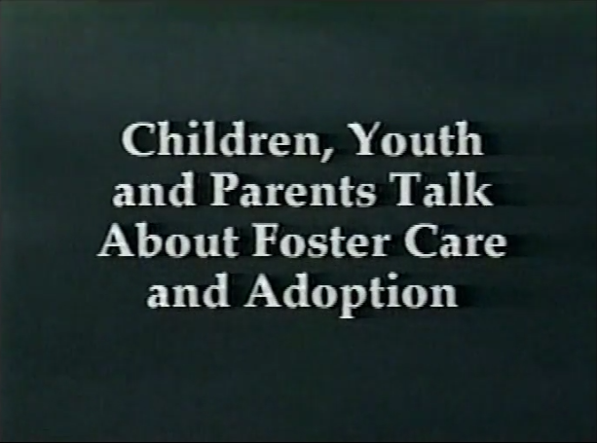
Video: Children, Youth and Parents Talk about Foster Care and Adoption (15 min)

Slide 12
Roadwork
Read Meeting 1 handouts – bring questions to Meeting 2
Talk about partnerships
Complete your Family Profile. Call with any questions

